Slide 2
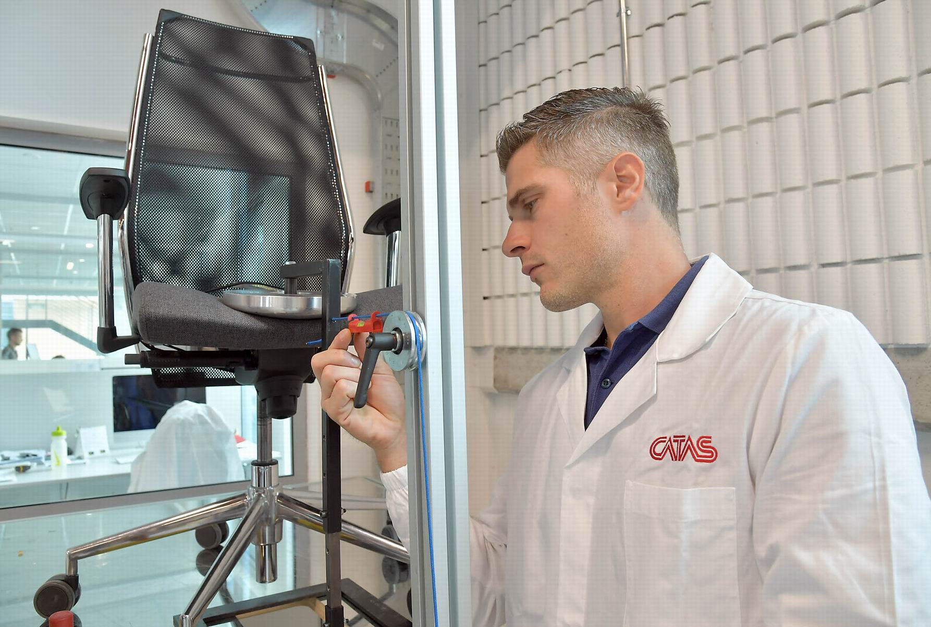
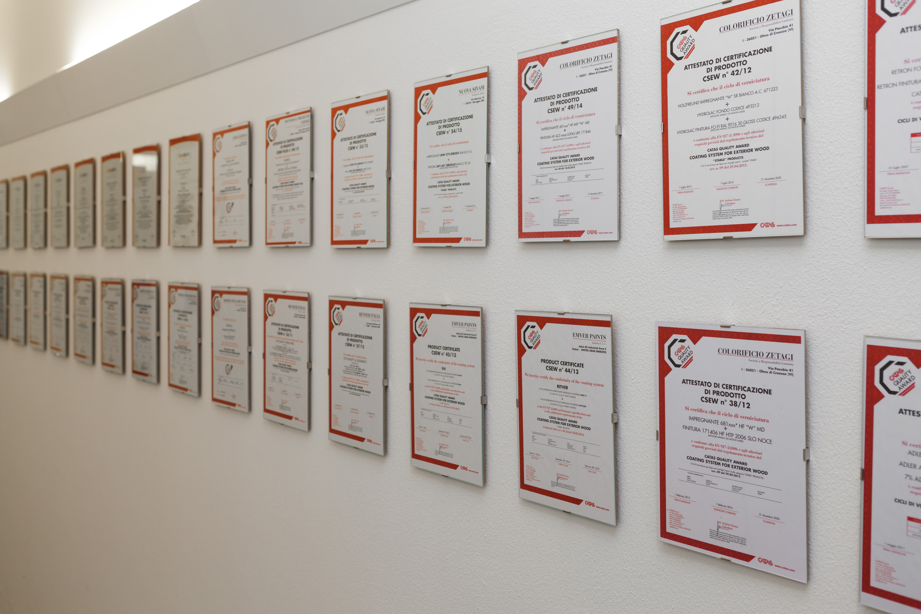
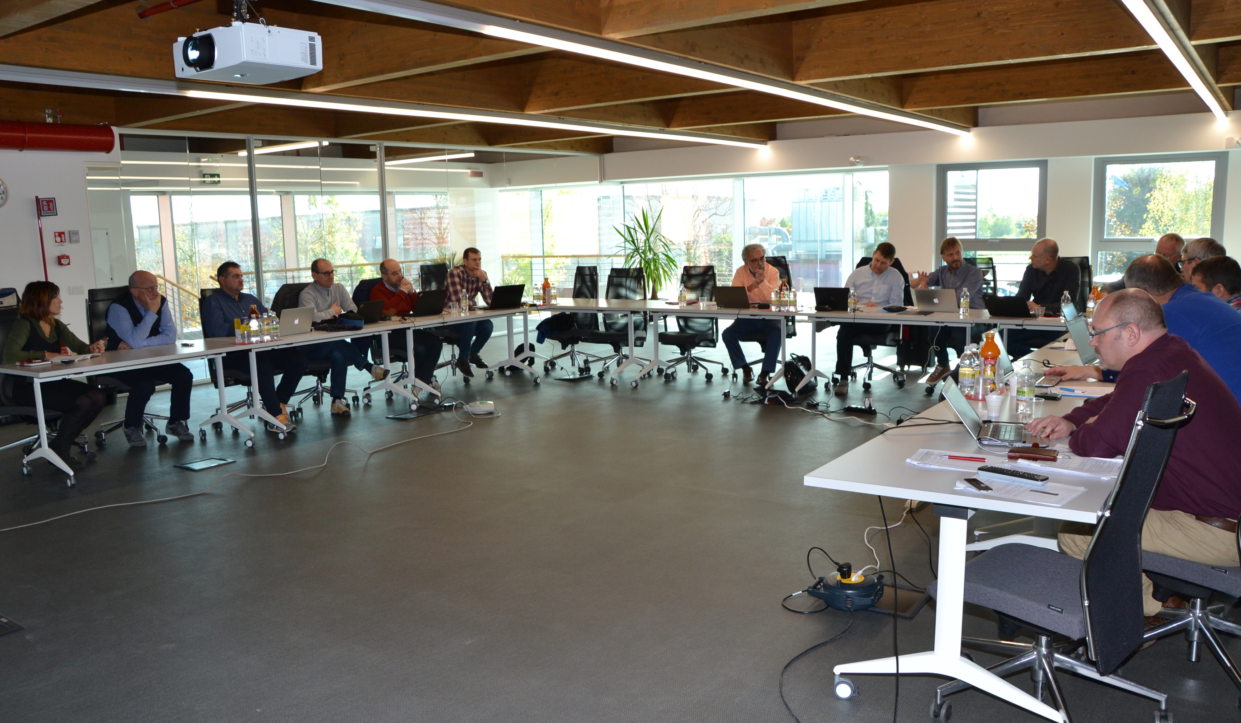
Testing
Certification
Training
Research
Standardization
Contribute to improving the
quality and reliability of products,
for the benefit of
users and environment,
carrying out tests with a
high level of competence,
and promoting the
training
of companies.

Slide 3
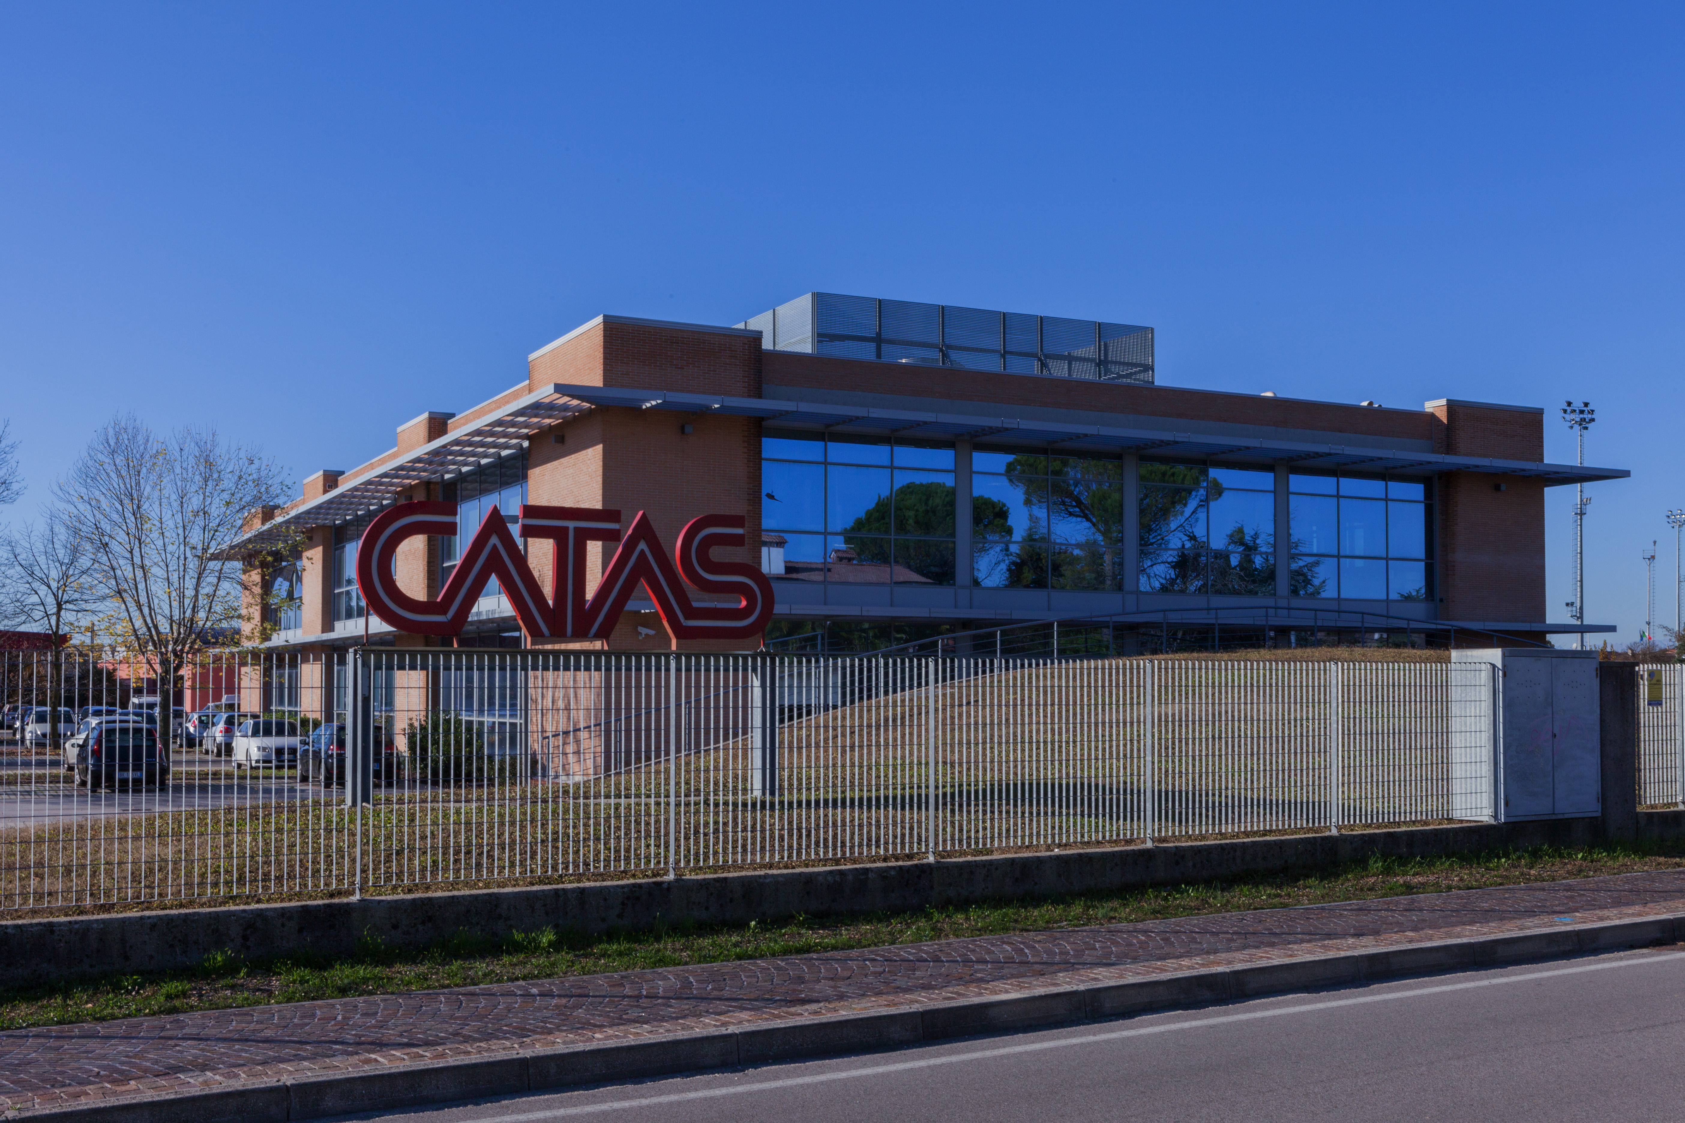
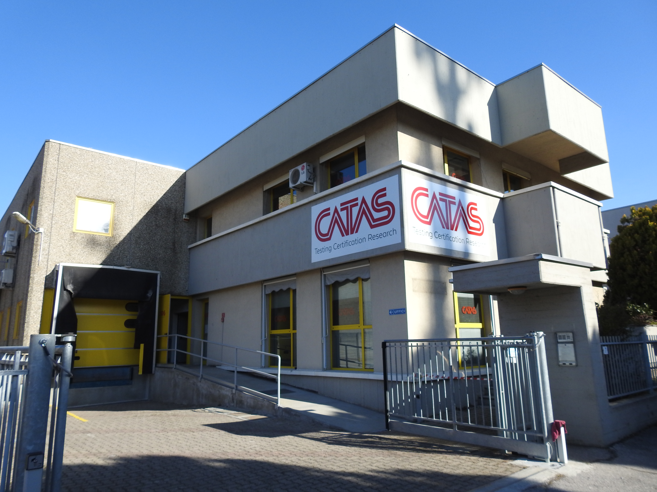


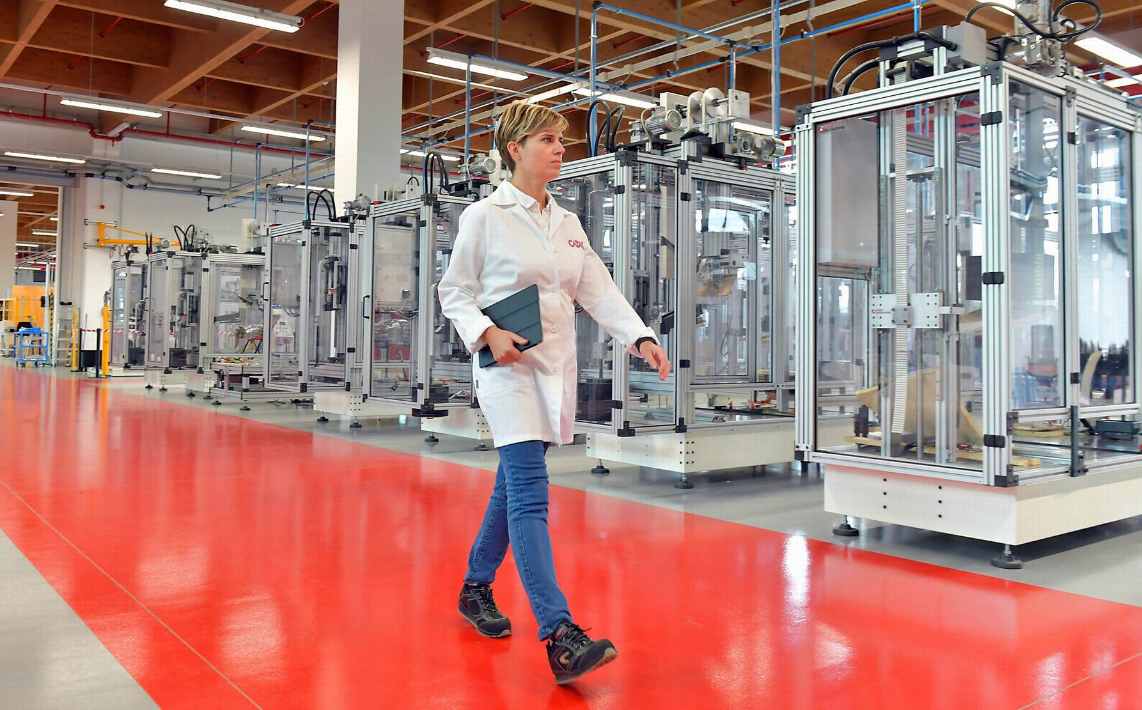
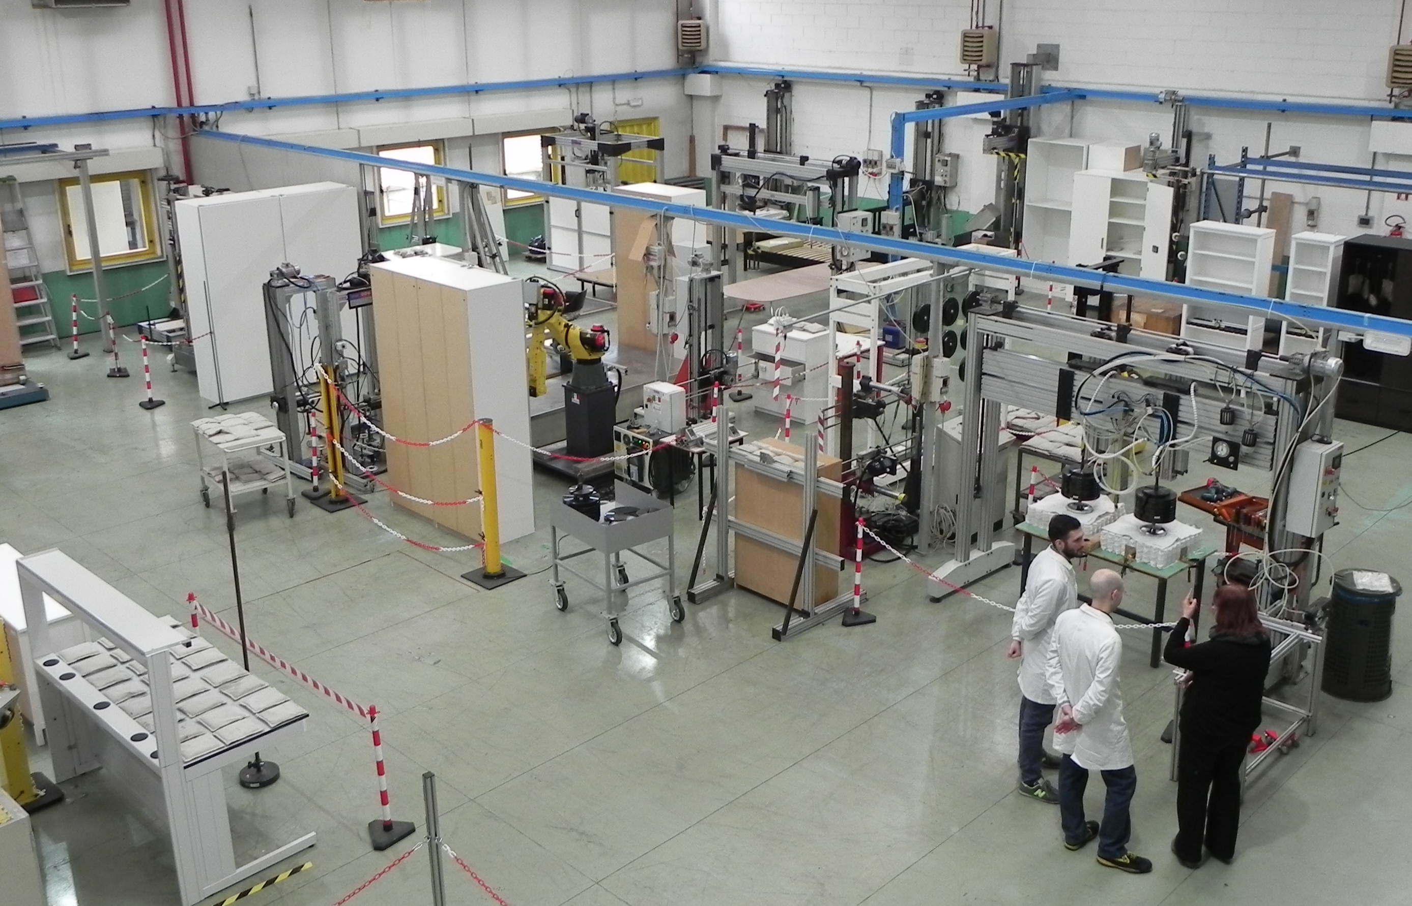
SITES
MARKET
S. Giovanni al Natisone (UD)
Lissone (MB)
10,000 m²
covered
area
2,000
customers
48,000
tests/year
55
countries

Slide 4
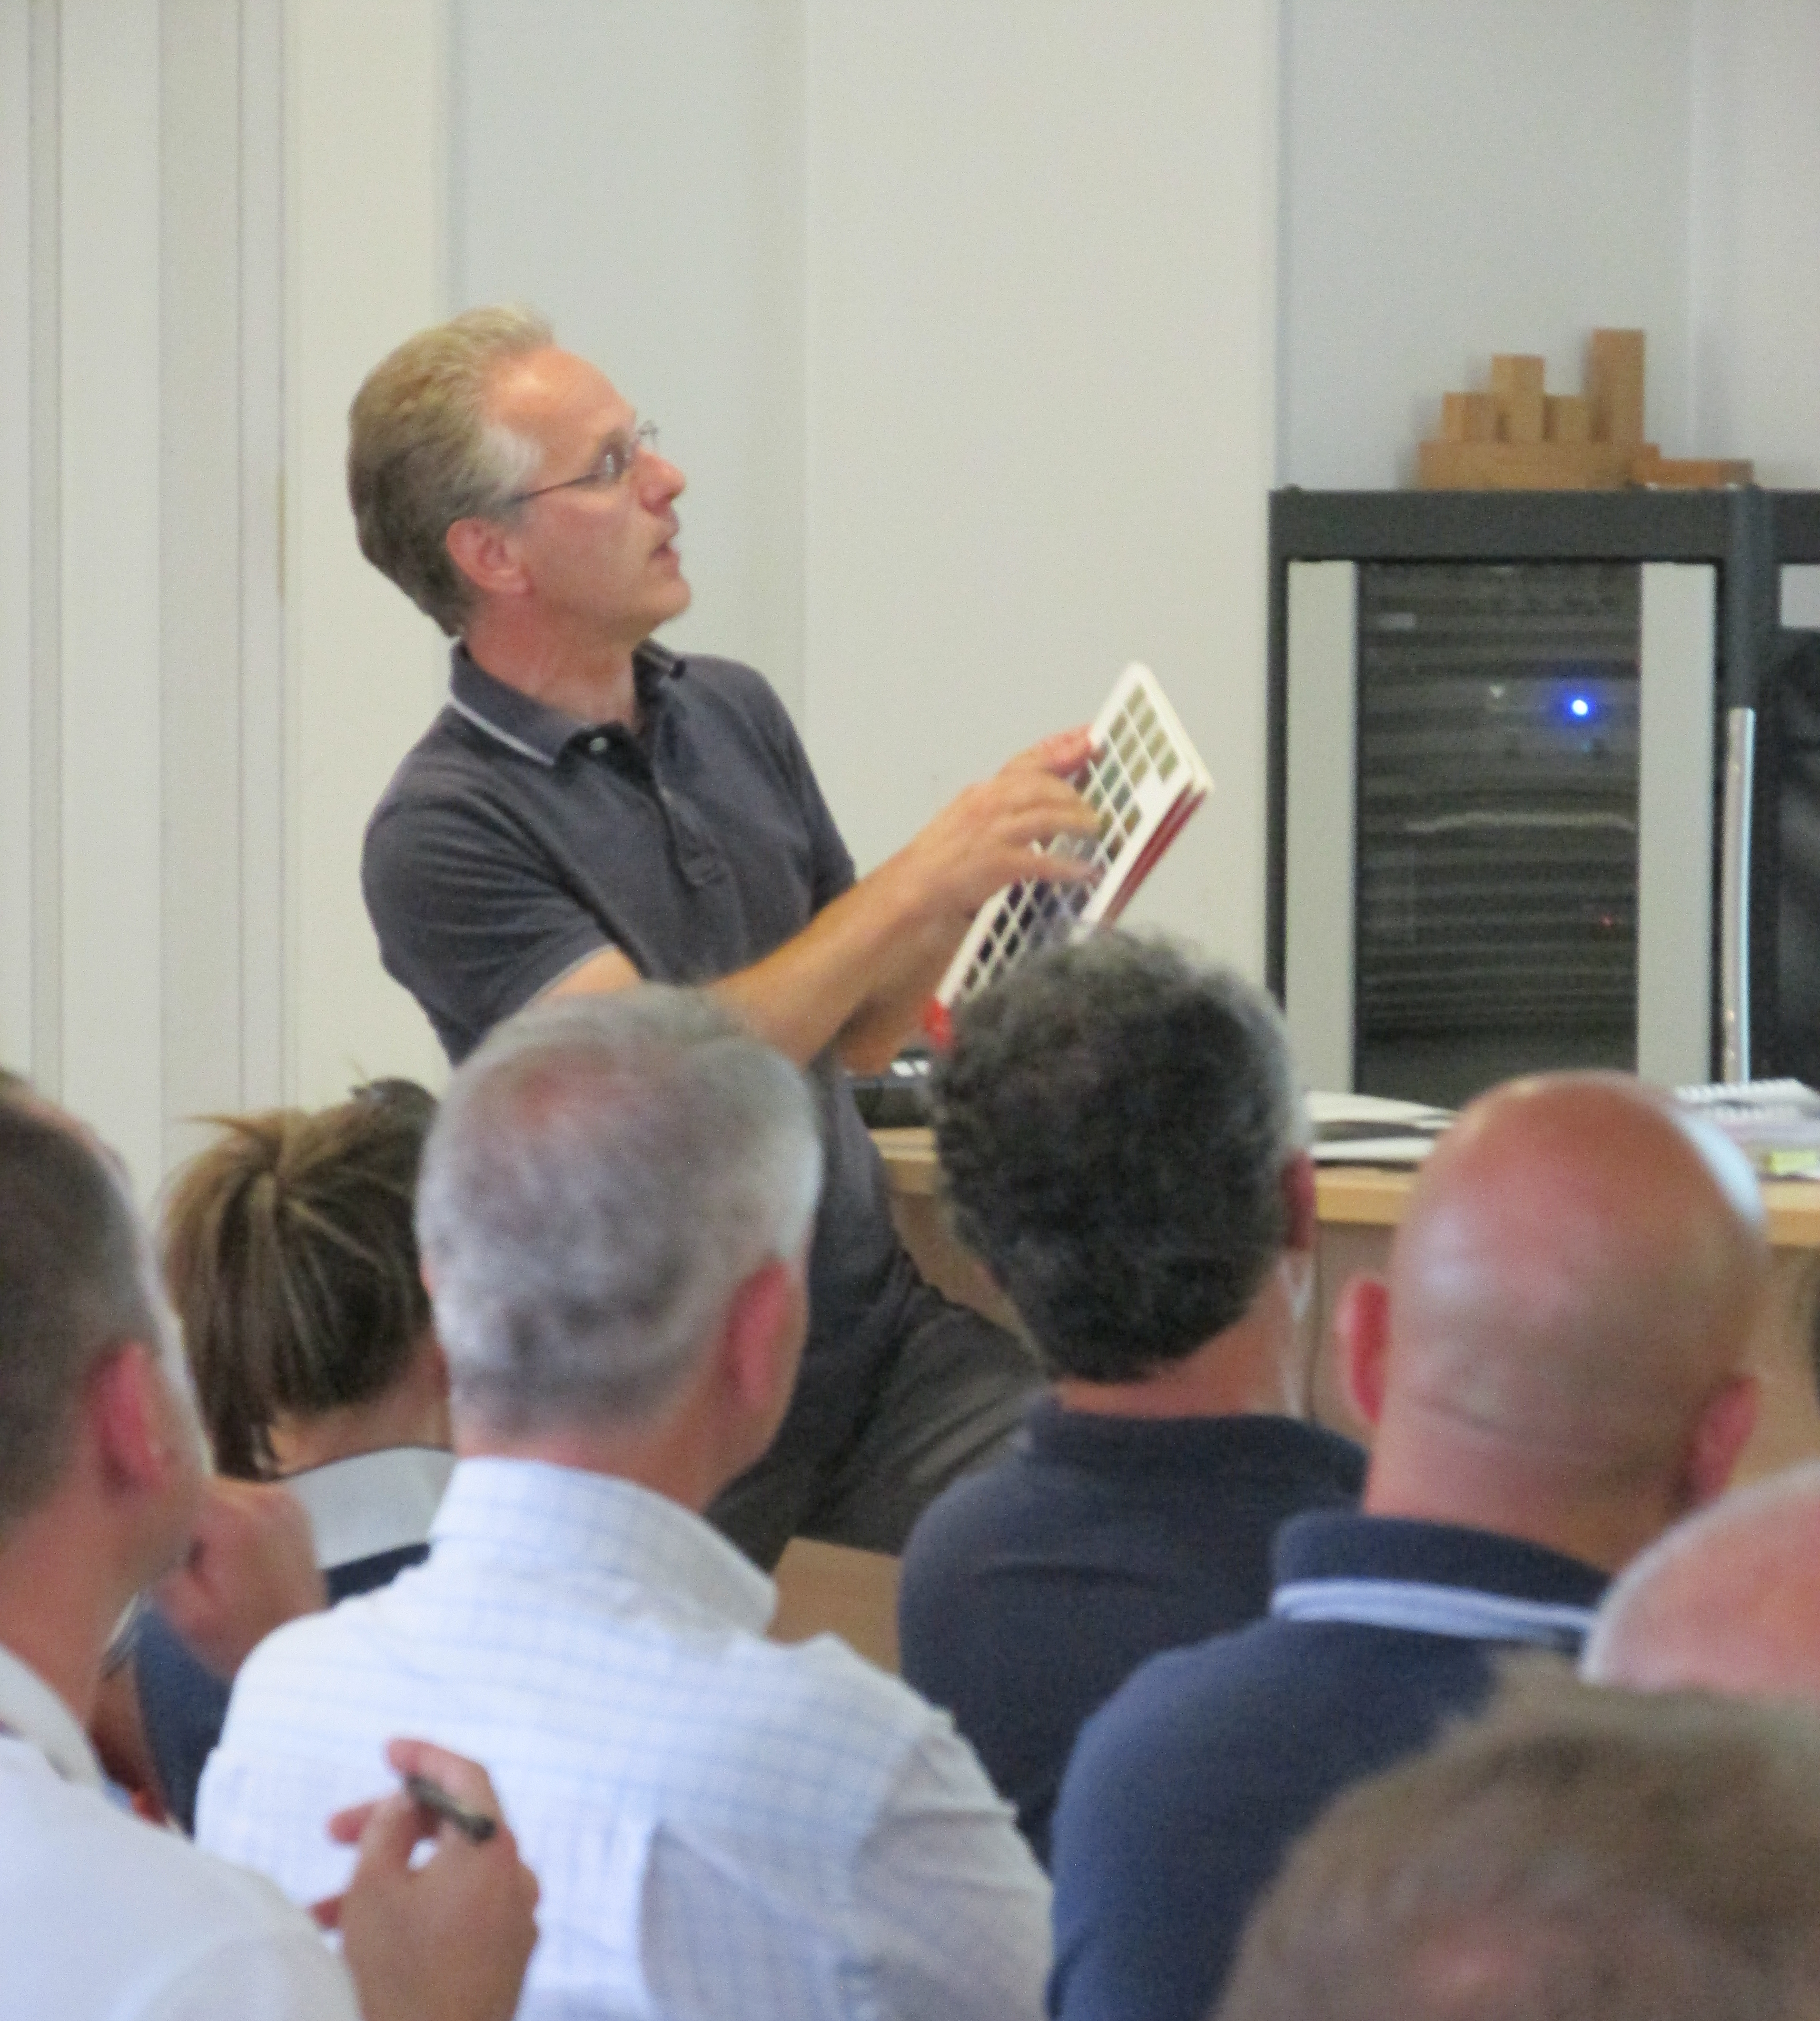
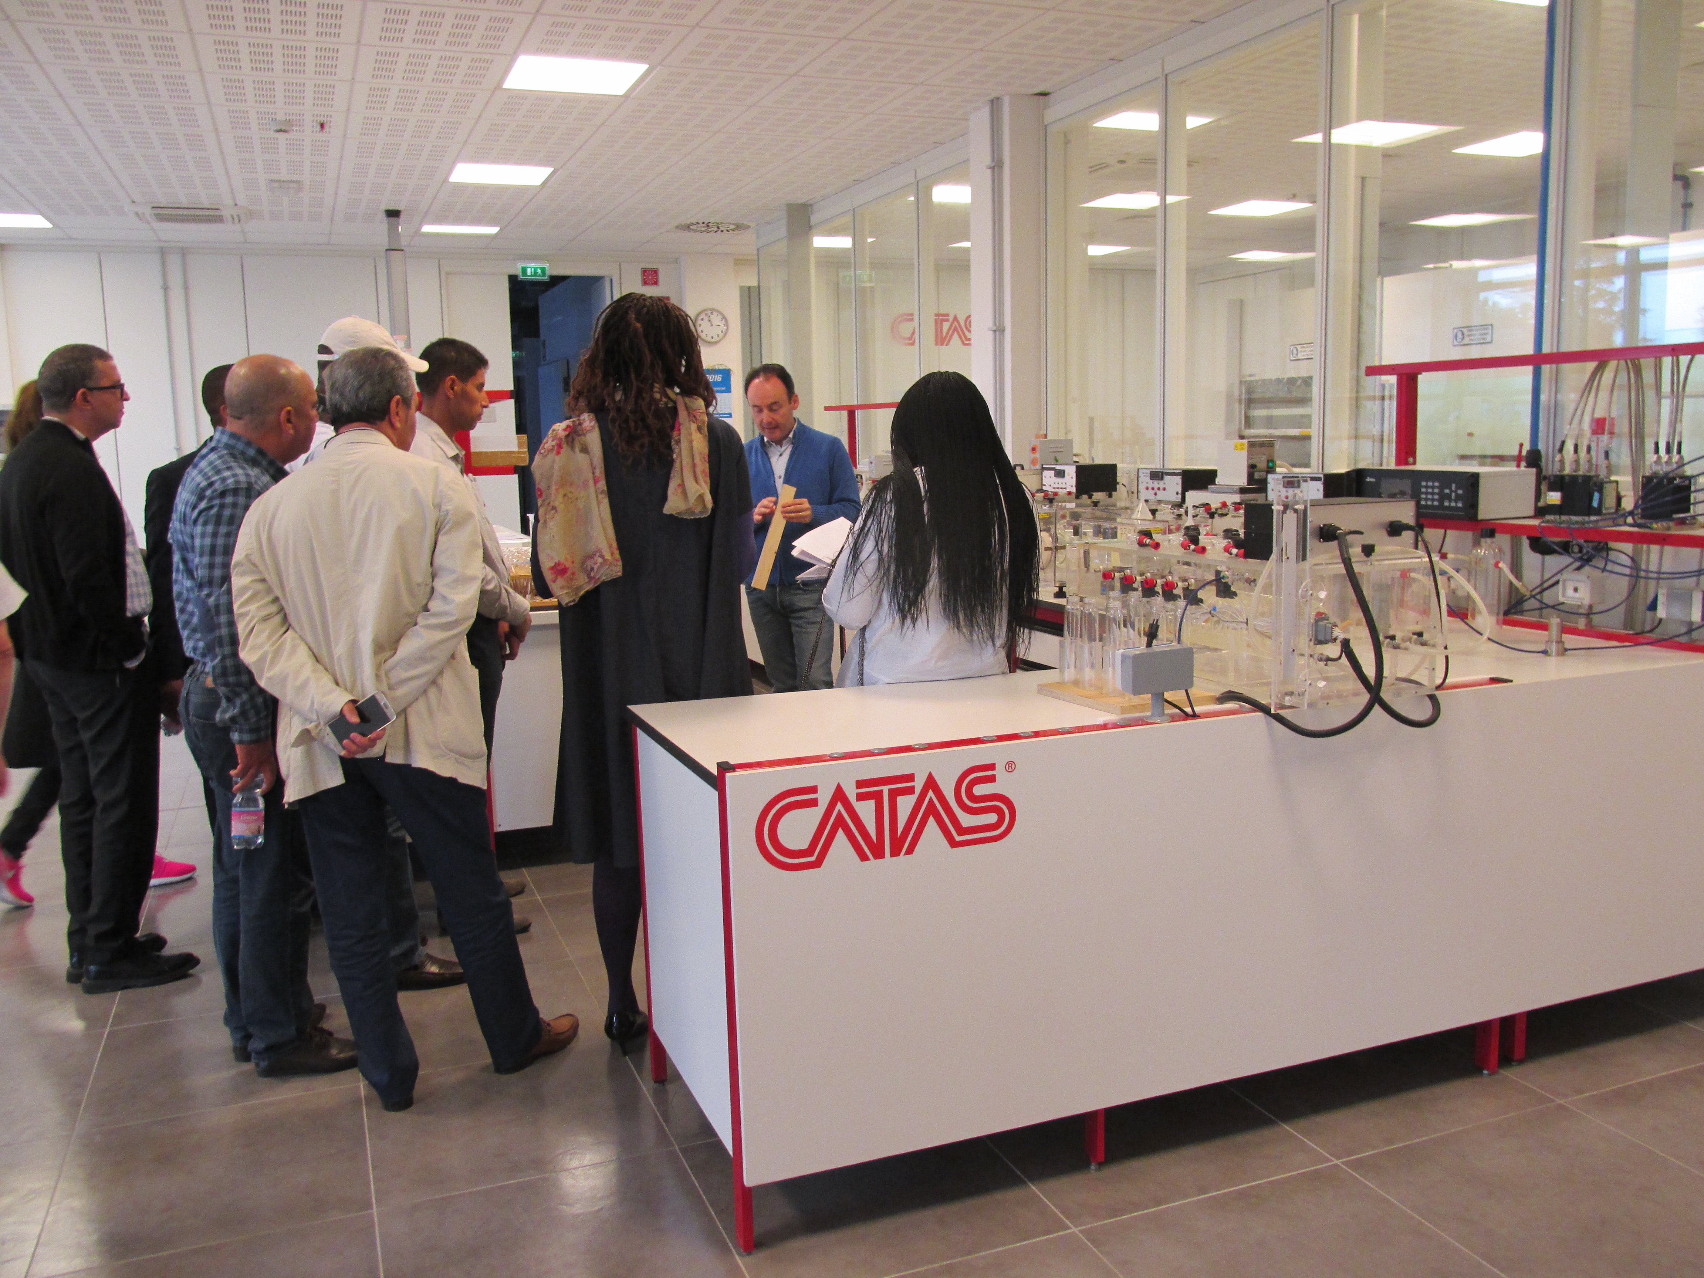
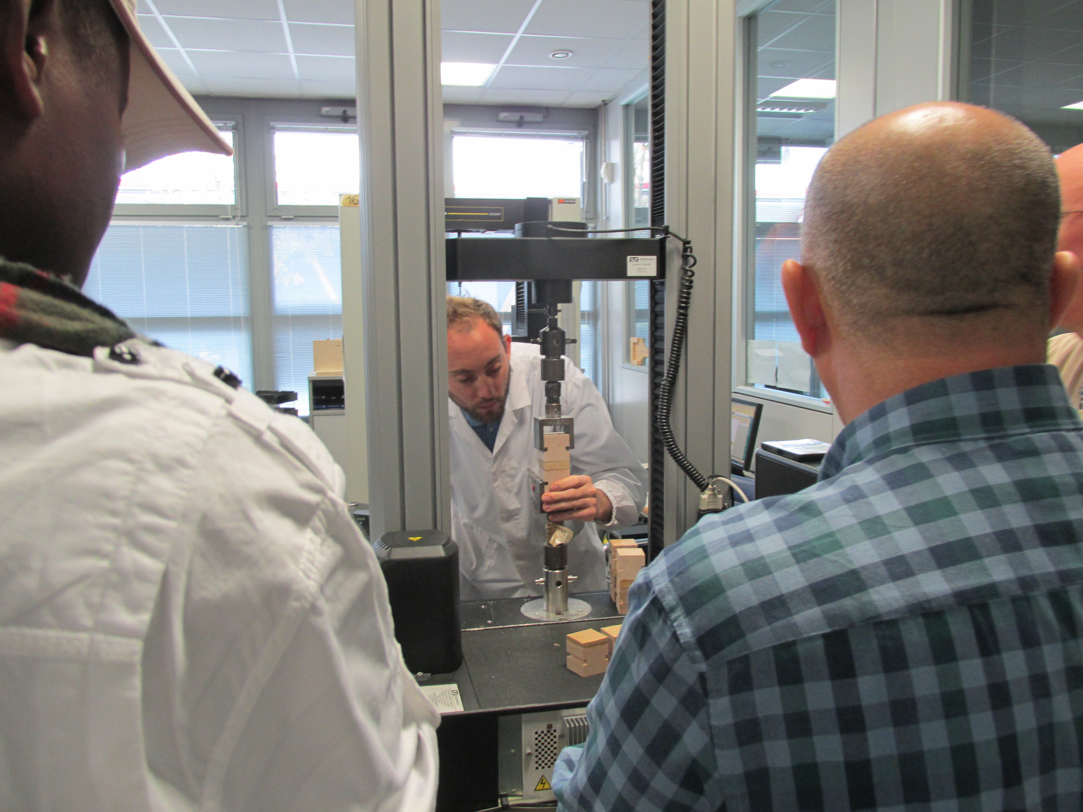
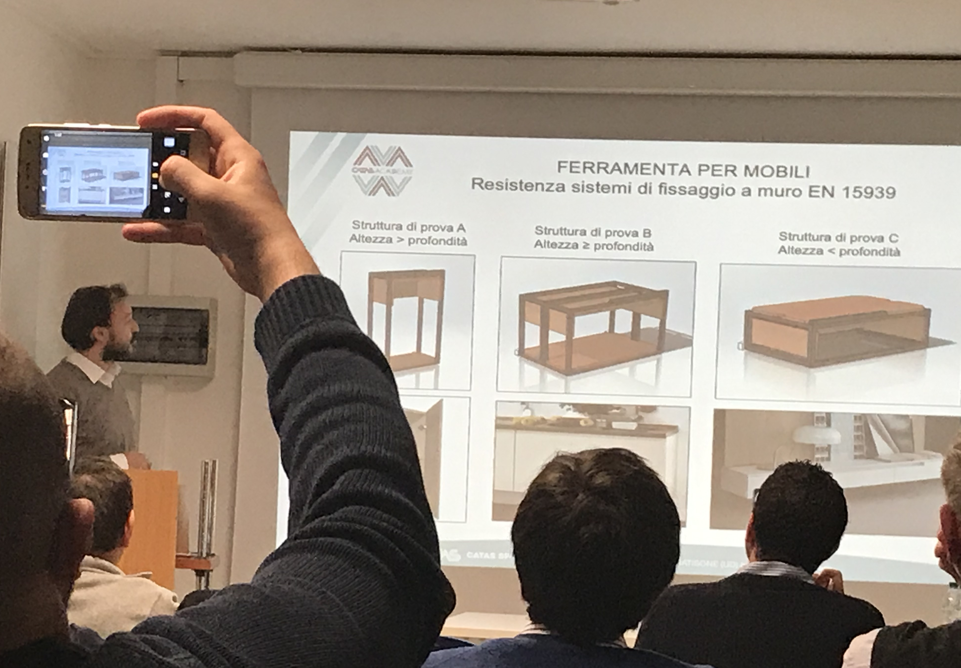

TRAINING
Promoting the culture of quality and safety in the sector
40
^{courses /year}
250
^{training}
^{hours / year}
Workshops
Seminars
Courses
on-demand

Slide 5

Surfaces of the future.
“Next Wood – Plan together the surfaces of the future”: how the coatings and plant producers face the challanges of the new coatings materials.
(Catas, Poliefun-Politecnico di Milano, Anver e Acimall)
Topics
@
Adhesives: trends and evolution.
“Adhesives for the furniture sector, products and processes evolution”: application processes and new products.
(Catas,Federchimica)
Indoor air quality.
“ Indoor emissions: formaldehyde and VOC”: materials chemical safety and product certifications in the current legislative and standardization framework.

Slide 6



