Slide 1


Slide 2

Milano, January 23rd, 2018

Slide 3
Welcome!

Slide 4
Dario Corbetta
Acimall Director

Slide 5
Marinella Loddo
Ice-Italian Trade & Investment Agency

Slide 6
Lorenzo Caprio
Fiera Milano President

Slide 7
Luigi De Vito
Eumabois Vice President

Slide 8
Lorenzo Primultini
Acimall President

Slide 9
Welcome!

Slide 10
Thanks to the speakers

Slide 11
XIE-Xylexpo Information Event
Biesse Group Leitz
Costa Levigatrici Leuco
Finiture Metal World
Giardina Group Scm Group
Greda Salvador
Homag Group Weinig Group

Slide 12
Xylexpo is the biennial world exhibition for woodworking technology and components for the furniture industry.

Slide 13
Xylexpo is the only woodworking machinery show in Italy!

Slide 14
Xylexpo is
Unlike other international fairs Xylexpo is entirely organized by an industrial association: Acimall, the italian woodworking machinery association.

Slide 15
Xylexpo is
Acimall is a non-profit association and Xylexpo is one of the promotional tools for the development of the industry.

Slide 16
Xylexpo is
Our goal is not increasing the profit, but building a self-sustaining platform where demand and offer can meet.
The show is a means, not the end!

Slide 17
Xylexpo has
50 years history; the first edition was organized in 1968.

Slide 18
Xylexpo 2016
441 exhibitors;
29,189 net square meters;
17,145 unique visitors (41,000 entrances),
14.2 per cent more than in 2014;
29.1 per cent international visitors.

Slide 19
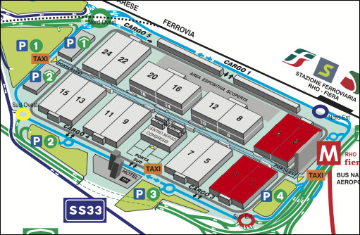
Xylexpo 2018: the halls

Slide 20
Hall 1 - 3
Technology for panel,
solid wood processing
and surface finishing, consumables and accessories
for the furniture industry

Slide 21
Hall 2 - 4
Technology for panel,
solid wood processing
and surface finishing;
first processing machines; consumable and accessories
for the furniture industry

Slide 22
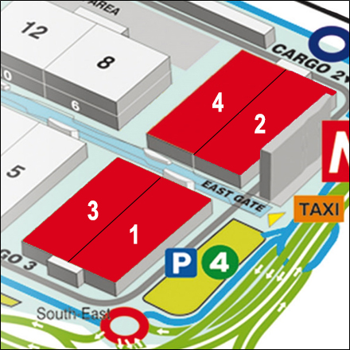
The “big players”
IMA/SCHELLING
WEINIG
HOMAG
CEFLA
SCM GROUP
BIESSE GROUP
BARBERAN

Slide 23
XIA-Xylexpo Innovation Award
Third edition.
For the first time four sections: Tools is the “new entry”.

Slide 24
Xylexpo Arena
A tradition, from 2010…

Slide 25
Xylexpo Evening
May 9th, 2018.

Slide 26
Thanks for your attention and see you at Xylexpo 2018!

Slide 27
Dario Corbetta
Acimall Director

Slide 28
Trend of the visitors (unique visitors)
+14.2%
Source: Xylexpo

Slide 29
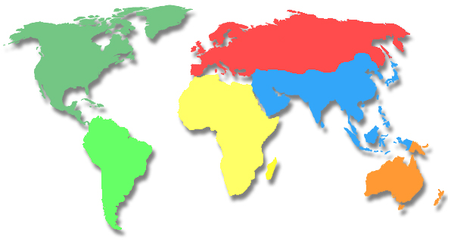
Origin of international visitors
Europe
71%
Asia
and Oceania
20%
Africa
3%
America
6%
Source: Xylexpo

Slide 30
Nature of business of the visitors
Source: Xylexpo

Slide 31
Visitors promotion: targets
Mass Marketing
Potential visitors
Web users
Incoming project
Press and journalists

Slide 32
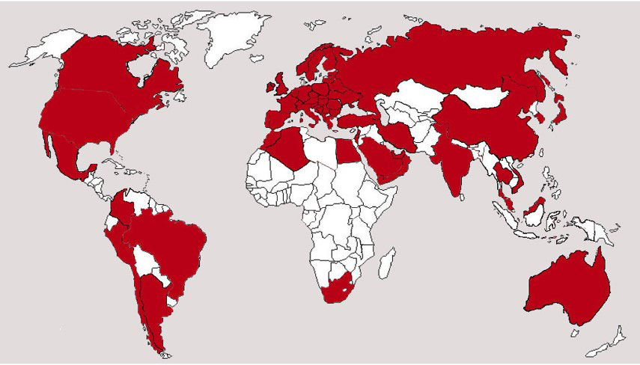
International visitors promotion
Promotion network

Slide 33
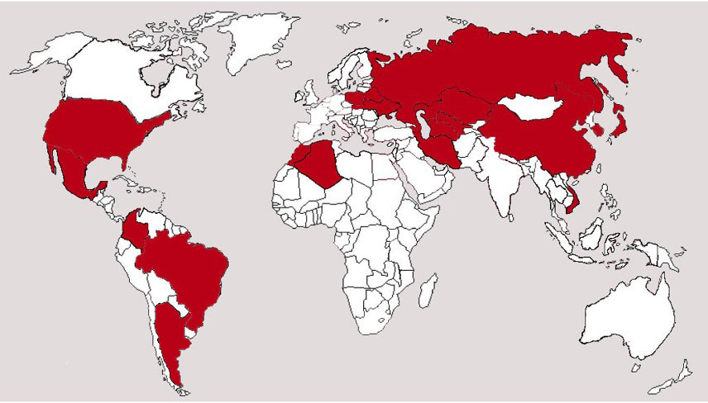
International visitors promotion
Incoming program map

Slide 34
Why Xylexpo 2018
Tradition
Xylexpo is celebrating its
50 anniversary.
Satisfaction
In 2016, 86% of exhibitors were satisfied with the number of visitors and quality of the event.
Relevance
Xylexpo is considered a strategic show for Italy and is supported by the Italian Ministry of Economic Development.

Slide 35
Not only…
Xylexpo is an high technology fair.
Xylexpo has over 300 direct exhibitors producing technology.
This element is unique in the international fair landscape in the even years.

Slide 36
Not only…
Xylexpo is the fair
of the technological comparison.

Slide 37
Not only…
Xylexpo is the fair of the international traders
of machines.
Traders coming from 60 different countries
uses to attend Xylexpo every edition.

Slide 38

Macroeconomic context

Slide 39
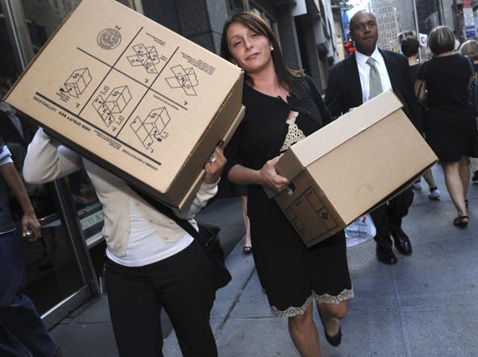
World GDP growth rate (%)
Historical series
Big crisis
Source: Imf

Slide 40
EU GDP growth rate (%)
Historical series
Second
crisis
Big crisis
Source: Imf

Slide 41
Italian GDP growth rate (%)
Historical series
Recovery
Second
crisis
Big crisis
Source: Imf

Slide 42
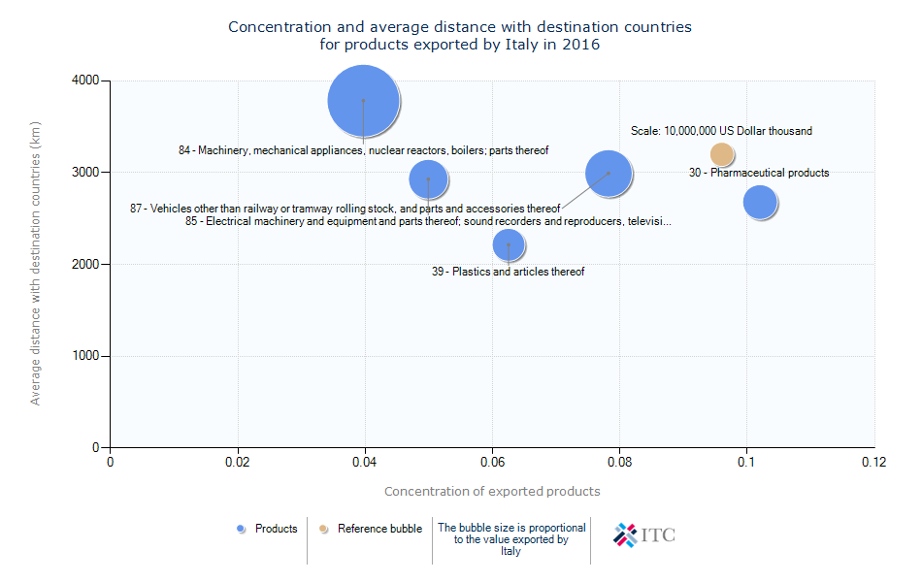
Features of the Italian exportation
Source: Imf

Slide 43
Industry 4.0: the Italian way
Government guidelines
A public investment of about 20 billion euro.
A super and hyper–amortization of 130% and 250%.
A 50% tax credit on R&D investments.

Slide 44
Industry 4.0: the Italian way
Example of tangible benefits for enterprises
Hyper-Depreciation
Example: 1,000,000 € investment
in advanced manufacturing solution.
Amortizable value: 250% of the purchase value
→ 5 years tax reduction equal to 360,000 €.

Slide 45
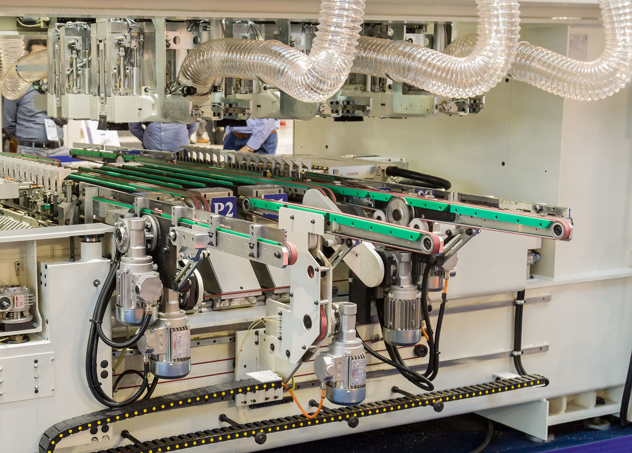
Woodworking industry trends

Slide 46
The process of woodworking industry
Felling and forestry
Primary industry, production of sawnwood,
sliced veneer and wood-based panel
Panel wood secondary industry
Solid wood
secondary industry
Machines and technical equipment for surface finishing

Slide 47
The process of woodworking industry
Felling and forestry
Primary industry, production of sawnwood,
sliced veneer and wood-based panel
Solid wood
secondary industry
Panel wood secondary industry
Machines and technical equipment for surface finishing
Italian industry
core business!

Slide 48
Woodworking machinery world export Historical series, million euro
Second
crisis
Big crisis
Source: Intracen

Slide 49
European production of woodworking machinery and tools
Historical series, million euro
Source: Eumabois

Slide 50
Woodworking machinery and tools in Europe: turnover share 2016
Source: Eumabois

Slide 51
Italian woodworking machinery and tools
Preliminary figures 2017
Economic variables | Value (Mio Euro) | % Var. (compared to 2016)
Production | 2,296 | 11.6
Export | 1,601 | 7.1
Import | 199 | 10.0
Trade balance | 1,402 | 6.7
Domestic market | 695 | 13.0
Apparent consumption | 894 | 20.3
Source: Acimall

Slide 52
Italian woodworking machinery and tools production
Historical series, million euro
Second
crisis
Big crisis
Source: Acimall

Slide 53
Italian woodworking machinery and tools market
Historical series, million euro
Source: Acimall

Slide 54
Italian Import of woodworking machinery
Estimation figures 2017
Country | Value (million euro) | Var.%
World | 199.0 | +10.0
Germany | 68.7 | 15.2
China | 24.1 | -8.3
Austria | 13.1 | 11.8
Switzerland | 10.7 | 31.4
France | 4.4 | -9.5
India | 4.2 | 68.8
Taiwan | 3.8 | -7.0
U.S.A. | 3.6 | 64.4
Spain | 3.6 | -27.9
Turkey | 3.3 | 22.6
Source: Xylexpo processing on Istat data.

Slide 55
Italian Export of woodworking machinery
Estimation figures 2017
Country | Value (million euro) | Var.%
World | 1,507 | 7.1
U.S.A | 165.5 | 4.5
Germany | 105.8 | 8.7
Poland | 102.4 | 22.6
France | 92.5 | -5.0
China | 88.5 | 31.3
U.K. | 61.1 | -40.9
Spain | 56.1 | 5.8
Belgium | 55.9 | -7.9
Russian Federation | 48.0 | 38.7
Austria | 35.5 | 13.1
Source: Xylexpo processing on Istat data.

Slide 56
Wood and furniture industry in Italy
Total turnover: 30 billion euro*.
Number of companies: 40,000**.
Number of employees: 360,000 units*.
Source: * Il Sole 24 Ore, Cgil;
** Acimall studies office estimation.

Slide 57
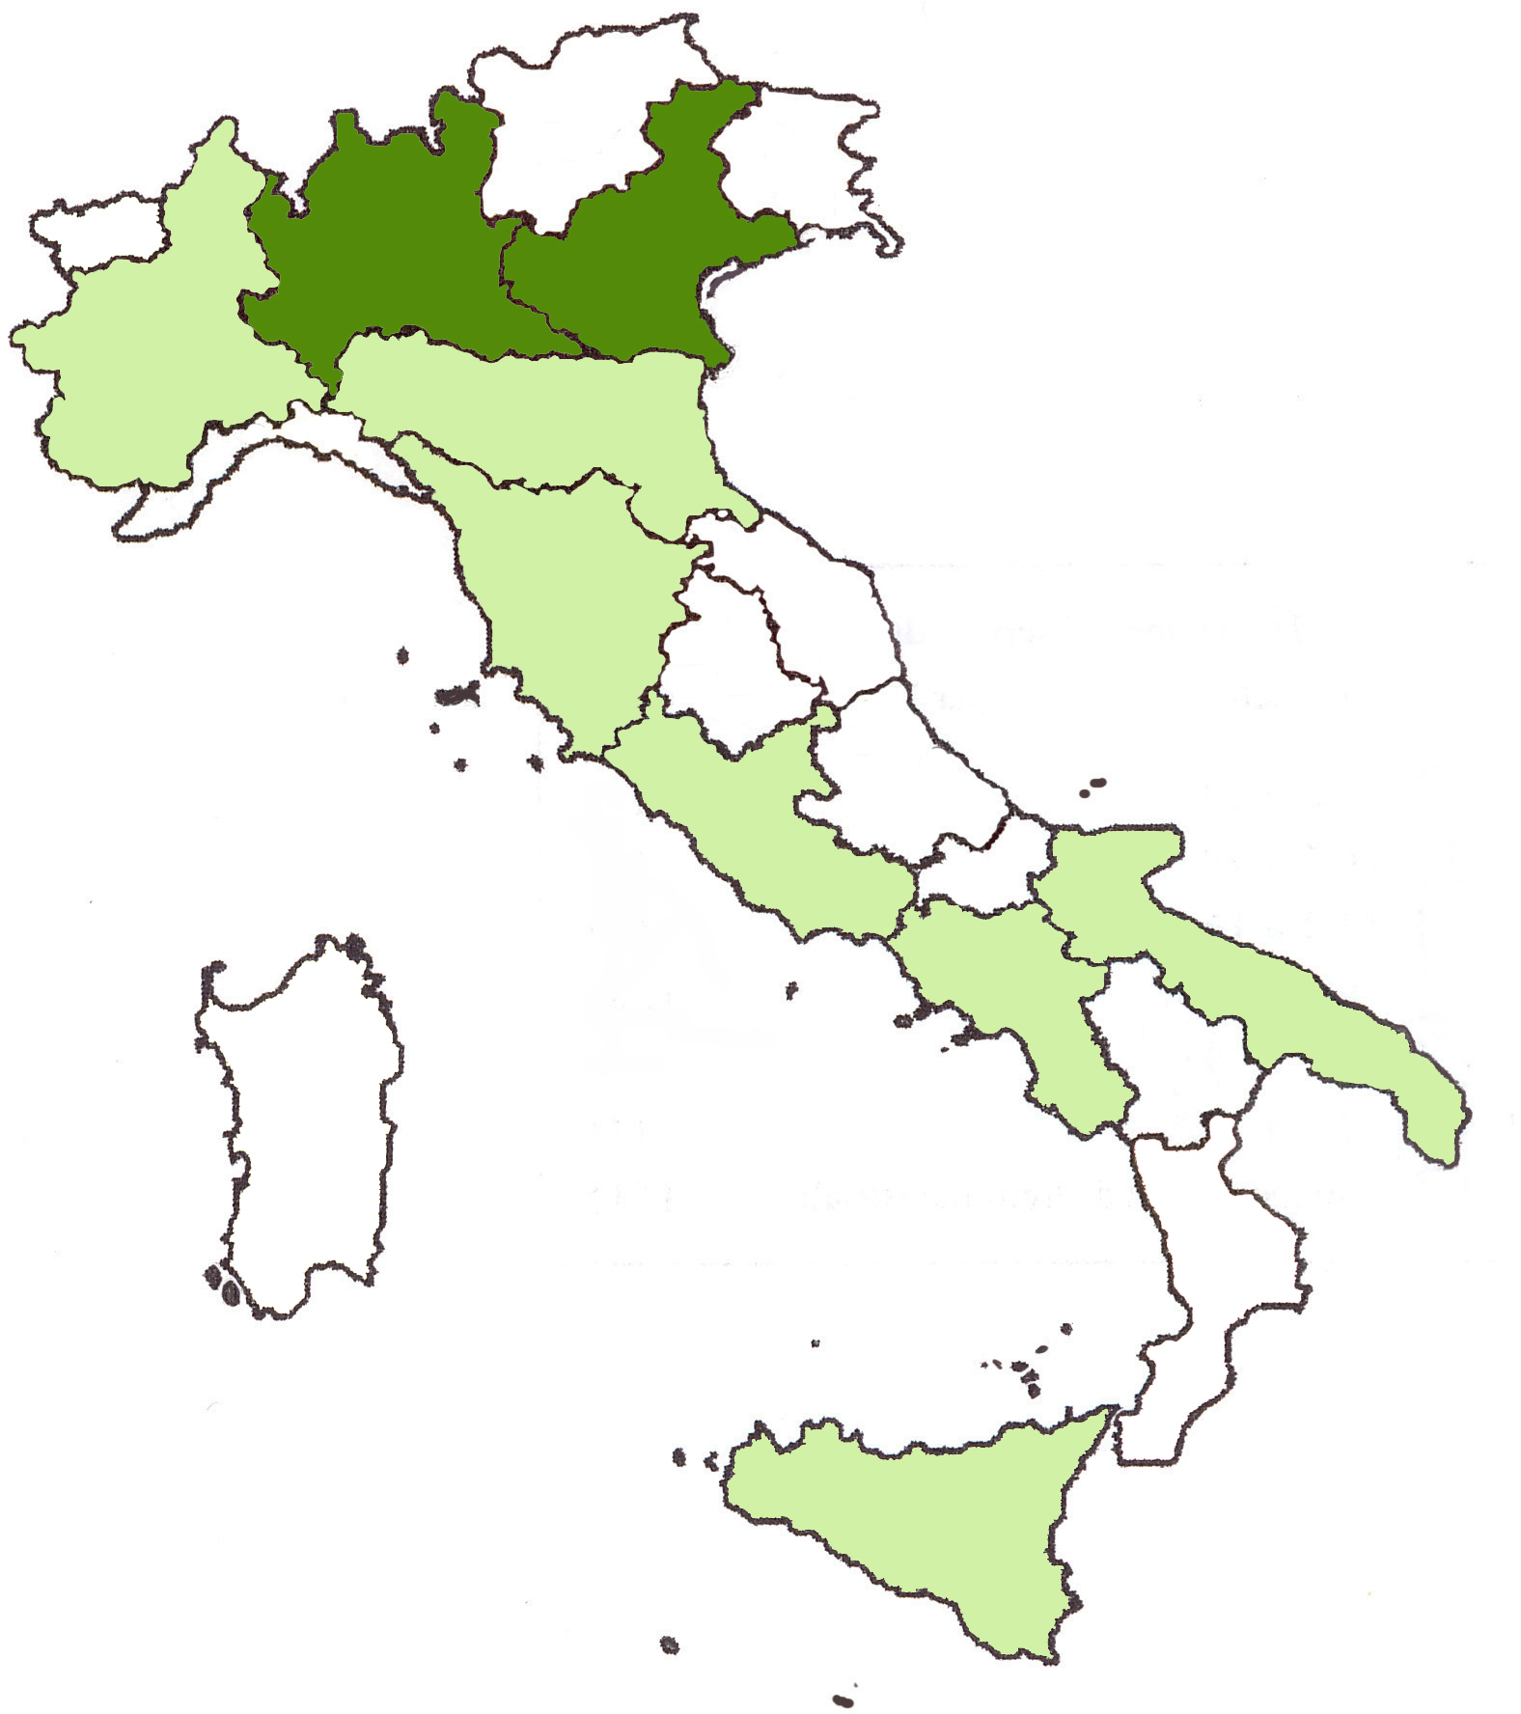
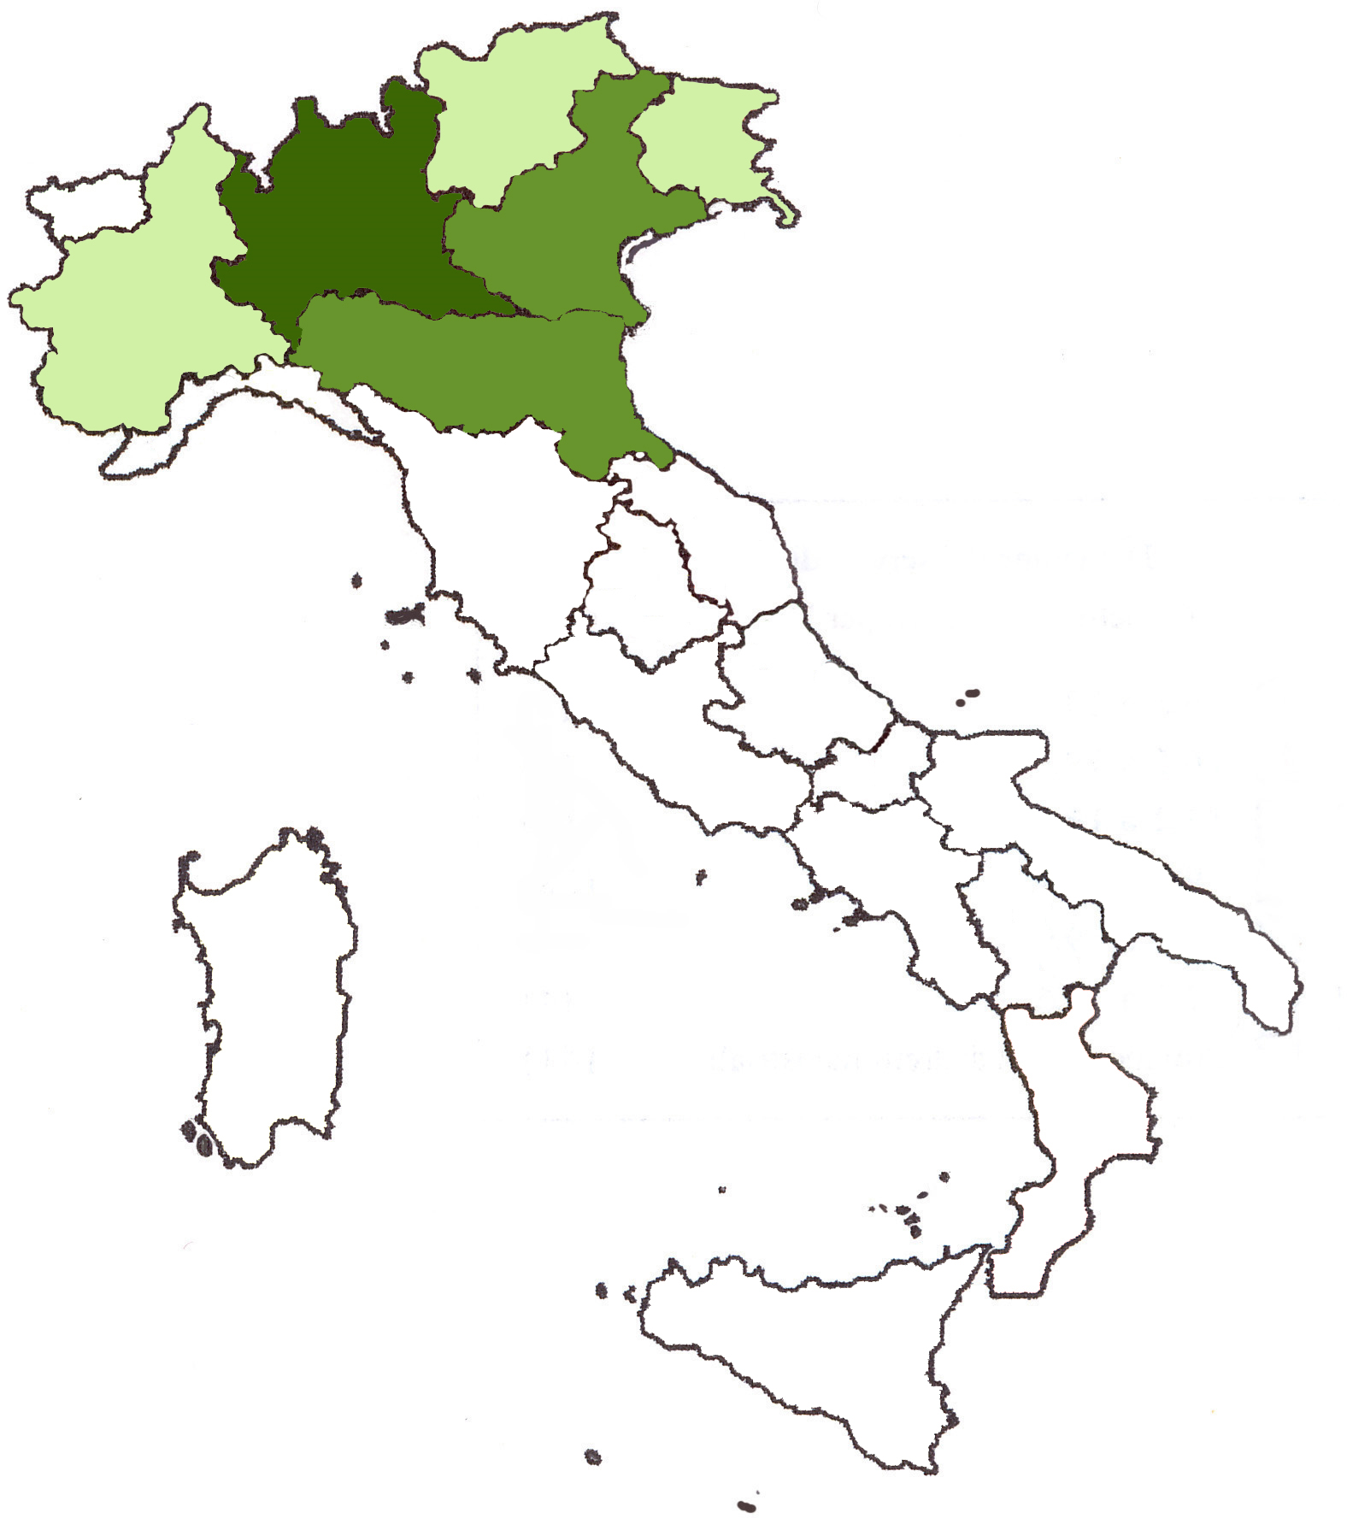
Concentration of the wood industry in Italy
Number of companies Turnover 2016

Slide 58
Italian and European production of wooden furniture in 2016 (million euro)
Source: Eurostat

Slide 59
Italian production of wooden furniture for offices
Historical series, million euro
Source: Eurostat

Slide 60
Italian production of kitchen furniture
Historical series, million euro
Source: Eurostat

Slide 61
Italian production of wooden bedroom furniture
Historical series, million euro
Source: Eurostat

Slide 62
Italian production of wooden furniture for dining-living room
Historical series, million euro
Source: Eurostat

Slide 63
Furniture industry worldwide
Top 10 export Countries
Country | Value (million euro)
World | 62,545
China | 21,333
Vietnam | 5,424
Italy | 5,005
Poland | 4,446
Germany | 4,287
Source: Intracen

Slide 64

Thank you for your attention!
Xylexpo
Tecnological
Excellence

